Slide 1
Practice With Hive
Section – 1 Group 2

Slide 2




Team Members
Akhil Kumar Reddy Busireddy
Anvesh Rokanlawar
Leela Krishna Kosaraju
Ravi Varma Devulapally

Slide 3
Agenda
What is Hive?
Why use Hive?
Hive features
Hive Architecture
Working of Hive
Hive Datatypes and Hive Operators
Demo
Leela Krishna Kosaraju

Slide 4
What Is Hive?
It is data warehouse infrastructure tool to process structure data in Hadoop. It resides on top of Hadoop to summarize Big data and makes querying and analyzing easy.
Initially Hive was developed by Facebook, later the Apache Software Foundation took it up and developed it further as an open source under the name Apache Hive
Leela Krishna Kosaraju

Slide 5
Why use Hive?
Hive helps programmers by reducing the need to write complex map reduce programs
HiveQL is similar to SQL, thus easy to learn and relate.
It is faster, scalable and extensible.
It is designed specifically for large datasets and to handle complex queries
Leela Krishna Kosaraju

Slide 6
Features
It stores schema in a database and processed data into HDFS
It is designed for OLAP
It provides SQL type language for querying called as HiveQL or HQL
Leela Krishna Kosaraju

Slide 7
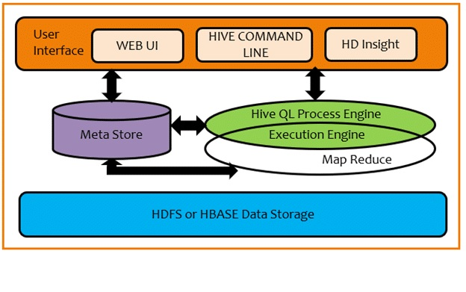
Hive Architecture
Rajender Ravi Varma Devulapally

Slide 8
Hive Architecture
User Interface – Creates interaction between user and HDFS.
Meta store - Hive chooses respective database servers to store metadata of tables, databases, columns in a table, their datatypes and HDFS mapping.
HiveQL process Engine – HiveQL is similar to SQL for querying on schema info on the Metastore. It is one of the replacement of traditional approach for Map reduce program.
Execution Engine – It is combination of HiveQL process engine and MapReduce. Execution Engine processes the query and generates the results as same as MapReduce results.
Rajender Ravi Varma Devulapally
Notes:
User Interface - Hive supports Hive Web UI, Hive Command Line and Hive HD Insight
HQL process Engine – instead of writing map reduce program in java, we can write a query for mapreduce job and process it.

Slide 9
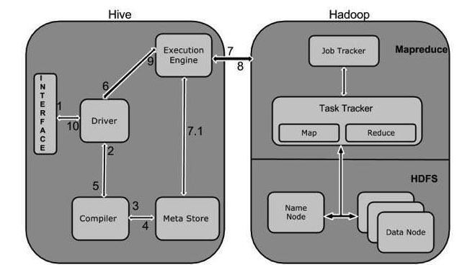
Working of hive
Rajender Ravi Varma Devulapally
Notes:
WEB Interface, CLI Interfce, Thrift server
Converts query to map reduce program
Does semantic analysis
Stores the structure information of tables etc
Executes the plan
Resource manager and desired output

Slide 10
Working of hive
Execute Query
Get Plan
Get & Send Metadata
Send & Execute Plan
Execute Job
Metadata Ops
Fetch & Send Results
Rajender Ravi Varma Devulapally

Slide 11
Hive Data Types
All datatypes in Hive are classified into four types –
Column Types
Literals
Null Values
Complex Types
Akhil Kumar Reddy Busireddy

Slide 12
Hive Data Types
Column Types:
Integral Types – INT, BIGINT, SMALLINT and TINYINT
String Types – VARCHAR and CHAR.
TimeStamp – format “YYYY-MM-DD HH:MM:SS.ffffffff”
Dates – format “YYYY-MM-DD”
Decimals
Union Types
Akhil Kumar Reddy Busireddy
Notes:
Union – collection of heterogenous datatypes.

Slide 13
Hive Data Types
Literals:
Floating Point Types – Ex: DOUBLE
Decimal Type – floating point value with higher range than DOUBLE datatype.
Complex Types:
Arrays – ARRAY<data_type>
Maps – MAP<primitive_type, data_type>
Structs – STRUCT<col_name: data_type [COMMENT col_comment, …]
Akhil Kumar Reddy Busireddy
Notes:
Decimal range -10 to 10

Slide 14
Hive Operators
There are four types of built-In operators in Hive. They are:
Arithmetic
Relational
Logical
Complex
Akhil Kumar Reddy Busireddy

Slide 15
Hive Operators
Arithmetic Operators :
Support various common arithmetic operations on the operands. All of them return number types.
Ex : A+B, A-B, A*B, A%B etc.
Relational Operators:
Used to compare two operands.
Ex : A!=B, A<B, A IS NULL etc.
Akhil Kumar Reddy Busireddy

Slide 16
Hive Operators
Logical Operators:
The operators are logical expressions. All of them return either TRUE or FALSE.
Ex : A&&B, A || B, !A etc
Complex Operators:
These operators provide an expression to access the elements of Complex Types.
Ex : A[n], M[key], S.x
Link:
https://www.tutorialspoint.com/hive/hive_built_in_operators.htm
Akhil Kumar Reddy Busireddy
Notes:
A[n]- array of type int
M[key] – map with key
S.x – S is struct.

Slide 17
DEMO
Anvesh Rokanlawar

Slide 18
reference
https://www.tutorialspoint.com/hive/hive_introduction.htm
https://www.tutorialspoint.com/hive/hive_built_in_operators.htm

Slide 19

Any questions
Anvesh Rokanlawar

Slide 20

Thank You
Anvesh Rokanlawar

